Slide 1
EEE
Eco-System Payments in Supply Chains
(some opportunities?)
Rocco Macchiavello
r.macchiavello@lse.ac.uk

Slide 2
Plan
Intro
Two potential collaborations:
Nespresso
Farmer Connect
Conclusions

Slide 3
How to Approach This?
SUPPLY CHAINS
ECOS-
PAYMENTS
?

Slide 4
Topic & Research
From environmental
Topic appears to be relevant in many contexts: e.g., deforestation (palm oil, cocoa, cattle, …), pollution (e.g., mining, waste disposal, …) conservation (e.g., fisheries) …
From supply chain
Typically, environmental regulations / programs / NGOs generate data on supply chains that are difficult to get …
Not comprehensive as VAT,
But often more detailed on certain aspects

Slide 5
Supply Chain Programs
Focus on deforestation / forest protection
e.g., Cargill,
Unilever
 |  | Purpose of Initiative
 |  | Goal Setting | Implementation
Actors Involved | Company | Company pledges | Codes of Conduct / Private VSS
 | Multiple Stakeholders | Collective aspirations | Sectoral Standards
e.g., RSPO

Slide 6
Supply Chain Programs
Focus on deforestation / forest protection
Challenges:
Leakage, Low Adoption Rates, Selective Adoption, Unintended (Social) Consequences
e.g., Cargill,
Unilever
 |  | Purpose of Initiative
 |  | Goal Setting | Implementation
Actors Involved | Company | Company pledges | Codes of Conduct / Private VSS
 | Multiple Stakeholders | Collective aspirations | Sectoral Standards
e.g., RSPO

Slide 7
Payments for Ecosystem Services
Definition: the exchange of value for land management practices intended to provide or ensure ecosystem services
Typologies (main):
User-financed PES
Government-financed PES
Compliance PES
Key issues:
Who are the beneficiaries? How easy it is to collect payments from them (e.g., watershed vs habitat conservation)
Transactions costs (including transparency, enforcement, commitments)

Slide 8
PES in Supply Chains
Not going to fix climate change (e.g., planting trees)
However:
Huge demand from companies to reduce CO2 emissions
Possibly implementation advantages
In particular on 2. a key challenge in many contexts is that beneficiaries are not organized to pay
E.g., watershed vs habitat conservation …
In the case of supply chain programs, companies might be able to get dispersed beneficiaries – i.e. environmentally conscious consumers – to pay at relatively low implementation costs
The supply chain is already organized to deliver differentiated products to consumers

Slide 9
PES, Consumers & Producers
If true, then some questions …
Are consumers willing to pay? If so for what?
Farmer/small-holder/producer is no longer only supplying a product (e.g., coffee) – (s)he is also supplying alternative “services”: e.g., forest conservation, bird habitat, etc
Potential to [significantly?] increase income (see, e.g., living income gap)
How critical is traceability?
Clearly necessary (but not sufficient!) for implementation, enforcement, M&E. But is it also critical for consumers?
Is this only in niche markets? Or can positive WTP be elicited also in more mainstream markets?
Remarkably little good evidence on this. Most evidence (including in marketing !) is not with actual purchasing decisions in the field. Mostly it is hypothetical / intention to purchase studies and/or labs with students

Slide 10
Opportunities
(NB: similar issues arise w.r.t. social & governance sustainability)*
Nespresso
Farmer Connect

Slide 11
Nespresso
A leading player in coffee -- & sustainability
AAA sustainable quality program the “flagship” buyer-driven VSS in the coffee chain
Program (see Macchiavello & Miquel-Florensa)
A vertical restraint: the contract between Nespresso & the exporter specifies conditions (a price premium) at which the exporter sources from the farmers.
Program already pays an additional premium to RF certified farmers*
A form of PES (?)
Invited Nespresso to participate in MG430
Group assignment on introducing PES in their program
They are interested in doing so in multiple origins
Nespresso already does a lot of environmental programs (& shared info)

Slide 12
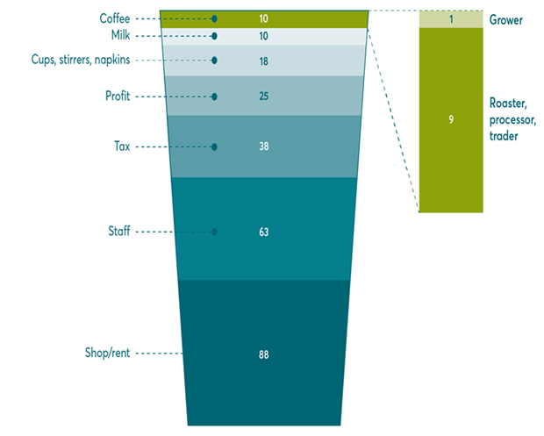
Nespresso
Tremendous potential.
Nespresso core capability:
Already figured out how to charge consumers a substantial premium
Breakdown of coffee
costs (not Nespresso!)
Even modest premia =>
Huge impact on farmers
Income (& incentives)

Slide 13
Farmer Connect
Start-up based in Geneva set up by Sucafina
One of the world’s largest traders of coffee -- & expanding. CEO is LSE alumnus
Involved in MG430 last years.
Integrated Block-chain Platform, 3 interconnected systems:
Farmers → being rolled out now
[Supply-Chain*]
Consumer (Thank My Farmer)
Two RCTs “ongoing” (more if I can expand the team!)
Smuckers/Folgers 1850: 1st RCT on wtp for traceability on Amazon
Rwanda:
Impact of “donations” on farmers
Drivers of willingness to donate
Interest in environmental (e.g., Orang Utang Coffee)

Slide 14
Conclusions
I think this is a good area to do work
Intersection of Environmental / Development / IO-ORG
Huge demand from companies (and GVTs !)
Some connections already in place for phd students in early years of program
Several other contexts tbd
I think many of the issues also apply to “social/governance” compliance (labour law violations, human right abuses, etc)

